Slide 1

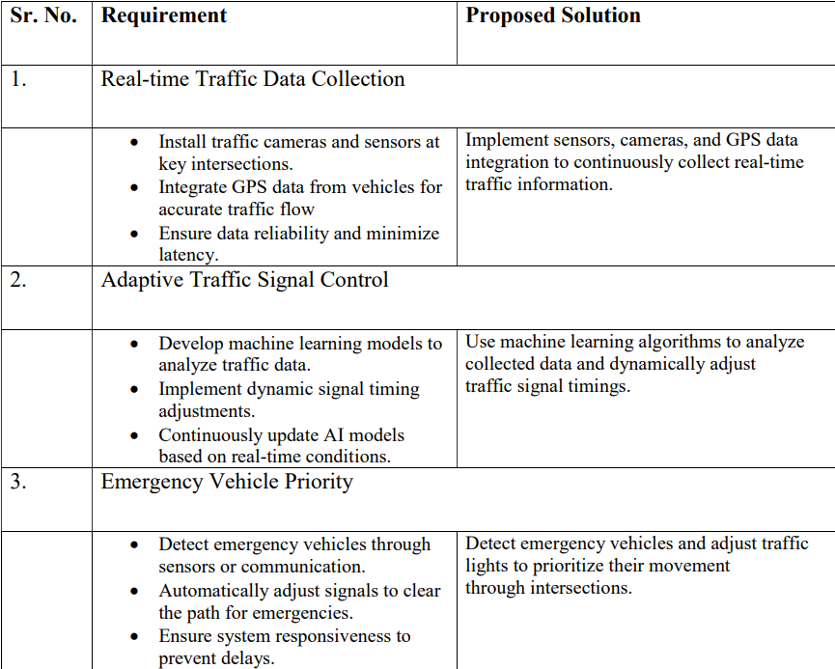
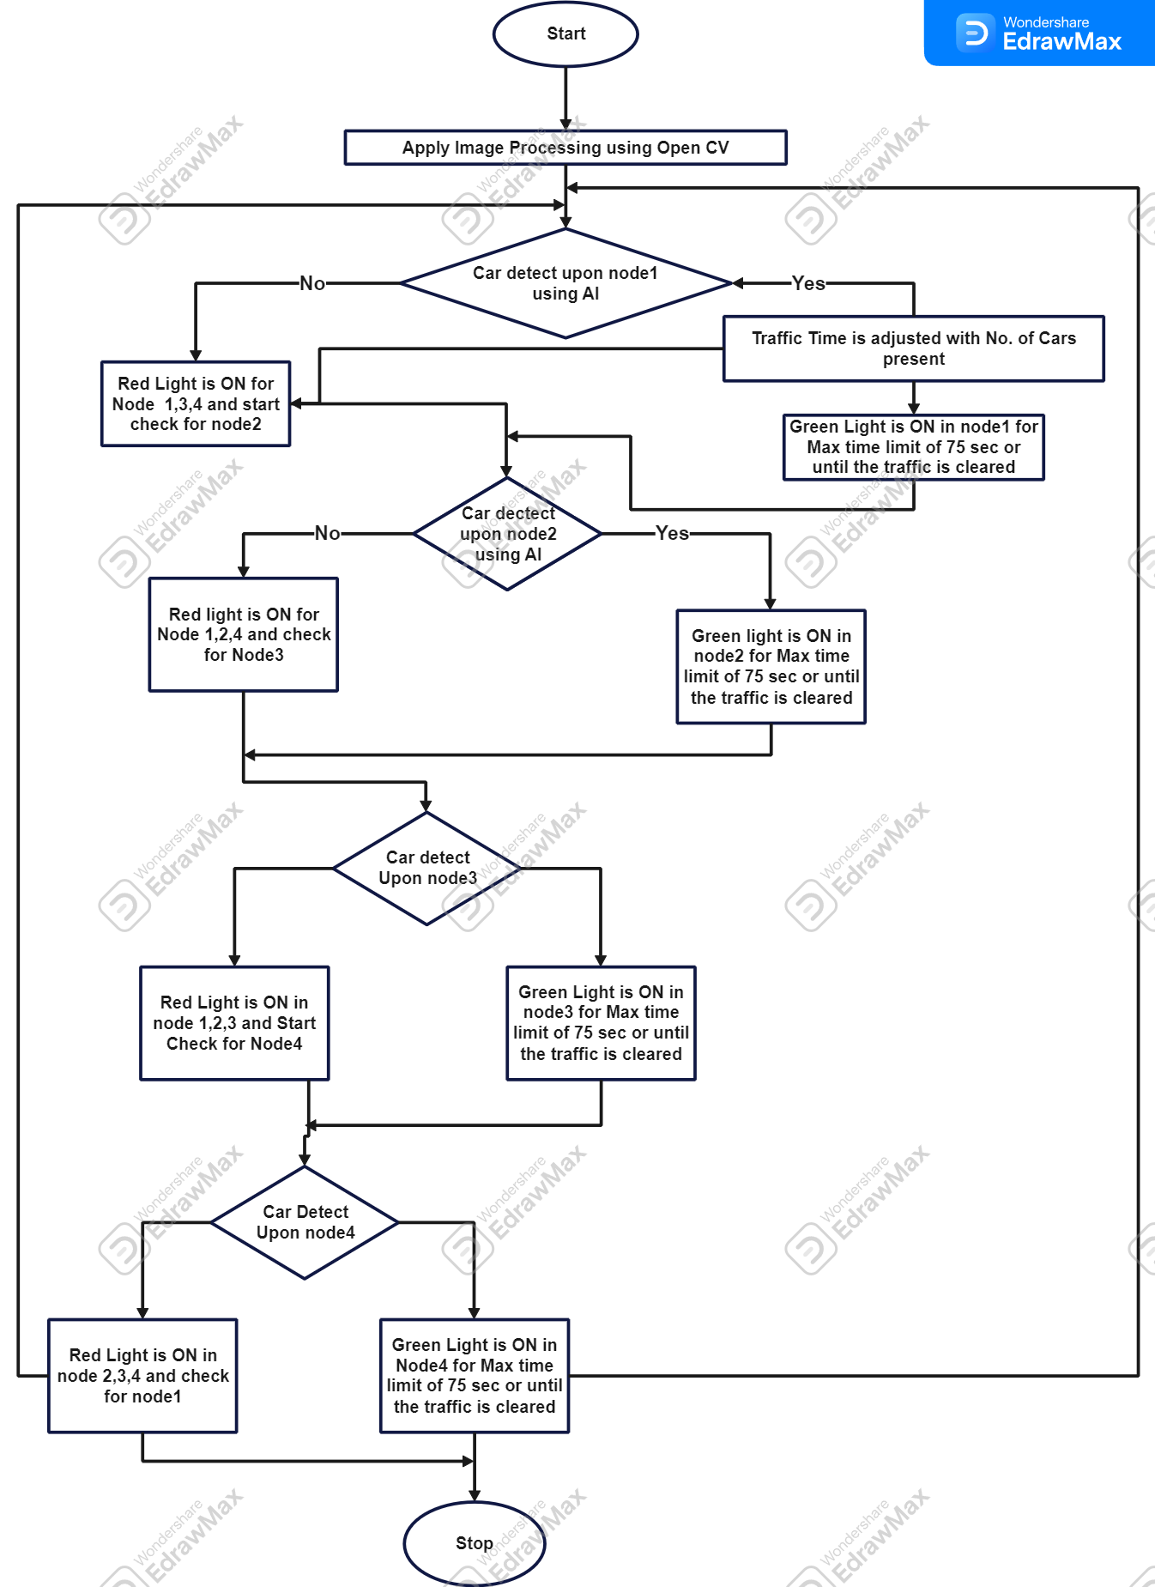
Proposed Architecture/ Diagram:
MIT SCHOOL OF COMPUTING
Class : TY-AIA-2
Group Id: 12
DEPARTMENT OF COMPUTER SCIENCE & ENGINEERING
Smart Traffic Light Control System
AI based methodology to control traffic lights as per real-time traffic
Arnav Sohani, Ishan Gaikwad, Omkar Lonkar, Samiksha Roy
Faculty Guide:
Prof. Vaibhav Sawalkar
What user Says:
“Traffic lights never seem to match the real traffic flow.”
"Why do I have to wait at a red light when there's no traffic coming?"
"There has to be a better way to manage traffic."
What user Thinks:
Current traffic systems are outdated and inefficient.
An AI-based system could really reduce congestion and save time.
This could improve road safety by reducing accidents caused by erratic traffic flow.
User
What user Does:
Stops at red lights even when there's no traffic, often leading to frustration.
Speeds up to make it through yellow lights, potentially risking accidents.
Looks for alternative routes to avoid congested intersections.
What User Feels:
Frustrated and stressed by long waits at red lights.
Impatient with the inefficiency of the current system.
Concerned about the environmental impact.
Problem statement
Urban traffic congestion is often worsened by outdated traffic light systems that fail to adapt to real-time conditions, leading to inefficiencies, increased travel times, and driver frustration.
Proposed Solution
Develop an AI-based trfffic light control system that uses real-time data from various sources such as cameras, sensors, and GPS data to optimize signal timings, reduce congestions and improve traffic flow.
Scope and Feasibility
The system can integrate with existing infrastructure, scale to different city sizes, and enhance future smart city technologies. Initial implementation requires significant investment in data collection and AI training but could greatly reduce congestion and improve urban mobility.

